Slide 1
Cryptocrystalline Variety of Quartz (SiO²)
Agates
And
Jaspers

Slide 2
Quartz SiO²
SiO² - Silicon Dioxide
Quartz
Cryptocrystalline
Microcrystalline
Macro crystalline
Chalcedony pronounced (kal-SED-uh-ni)
Quartz makes up more than 10% of the earth’s crust
Quartz is SiO²
Chalcedony is Quartz
Agates and Jasper are both Chalcedony (Cryptocrystalline)
Amethyst, Citrine, Smokey are Quartz (Macro crystalline)
Mohs Hardness 6-7
So what is the difference?

Slide 3
The difference/similarities
AGATE –
SiO²
Cryptocrystalline
Quartz
Chalcedony
Impurities
Light passes through
JASPER -
SiO²
Cryptocrystalline
Quartz
Chalcedony
Impurities
No light passes through

Slide 4
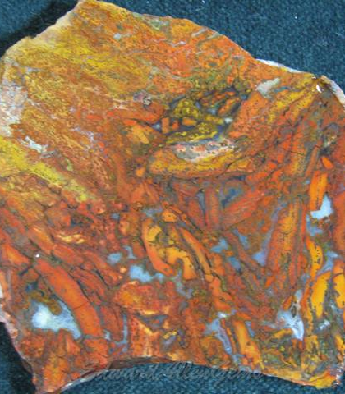
Jaspagate
When it meets all the other tests for agate or jasper but you can see through some spots but not others. JaspAgate

Slide 5
Agate - Types of inclusions
Banded
Fortification
Moss
Filament
Plume
Sagenite
Tube
Iris
Polyhedroid
Shadow
Dendritic
Eye
Pseudomorph
Water Level
Fire
Combinations

Slide 6
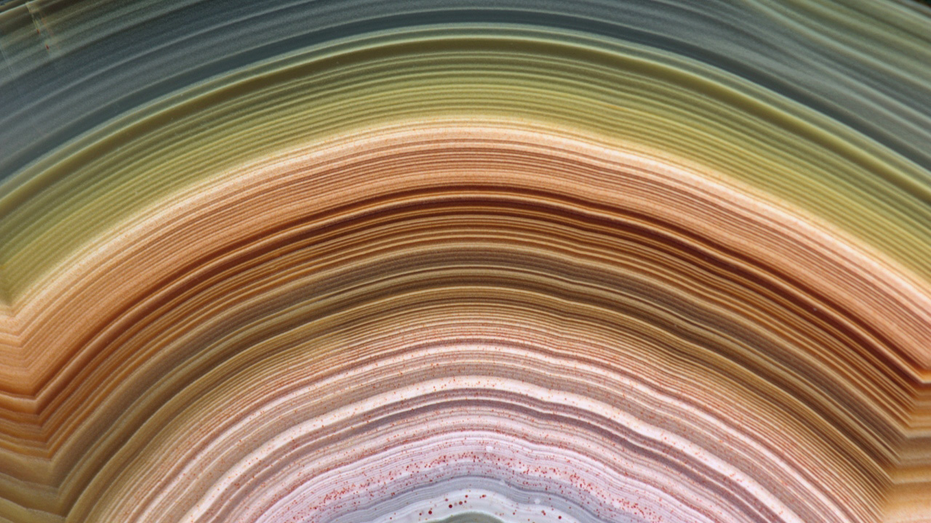
Banded
-Impurities coalesce in bands of alternating colors.
-Impurities can effect hardness slightly.
-Highly contrasting colors command higher prices.

Slide 7
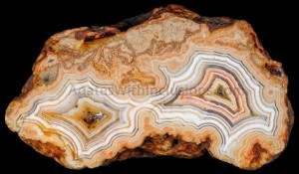
Fortification
-Impurities coalesce in bands of alternating colors.
-Impurities can effect hardness slightly.
-Highly contrasting colors command higher prices.
-Tight or sharp turns like the ramparts of a fort or castle
Fairburn's Agate

Slide 8
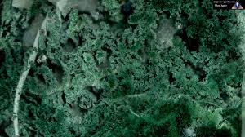
Moss
- Looks like moss or algae
- Can be any color
Horse Canyon Agate

Slide 9
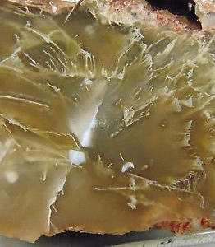
Filament
-Single threads or very light looking moss.
Fairburns Agate

Slide 10
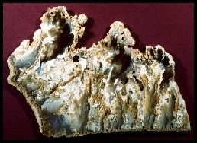
Plume
-Plumes look like feathers or small bushes
- Bright colors are the most valved by collectors
Graveyard Point Agate

Slide 11
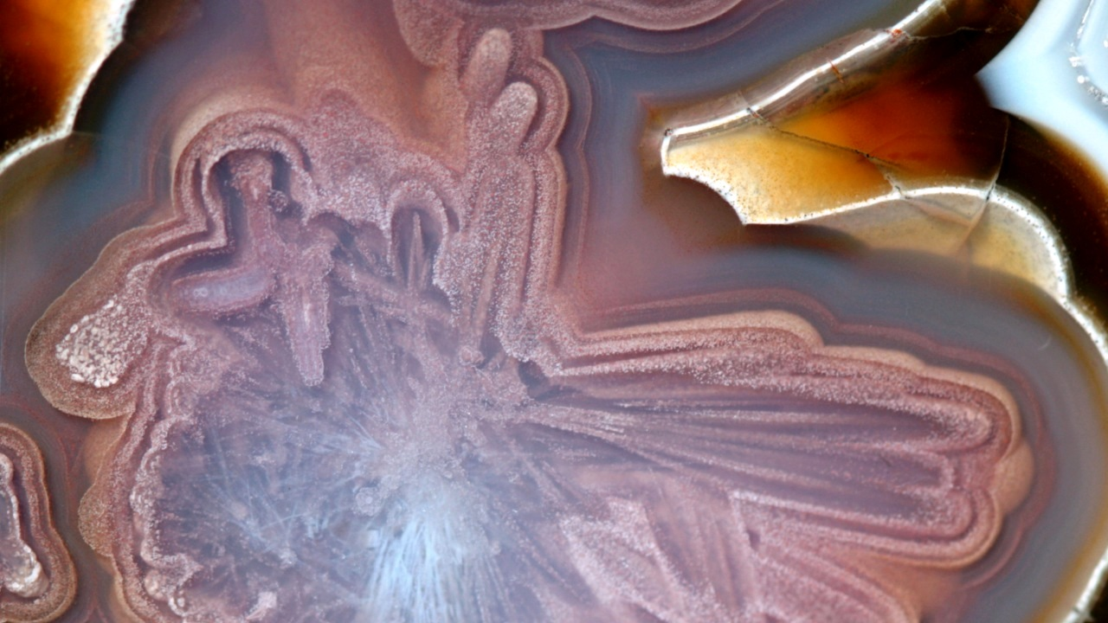
Sagenite
-needle like inclusions radiating outward.
-Usually of a single mineral.
-Sometimes replaced or covered by further banding
Agua Nueva Agate

Slide 12
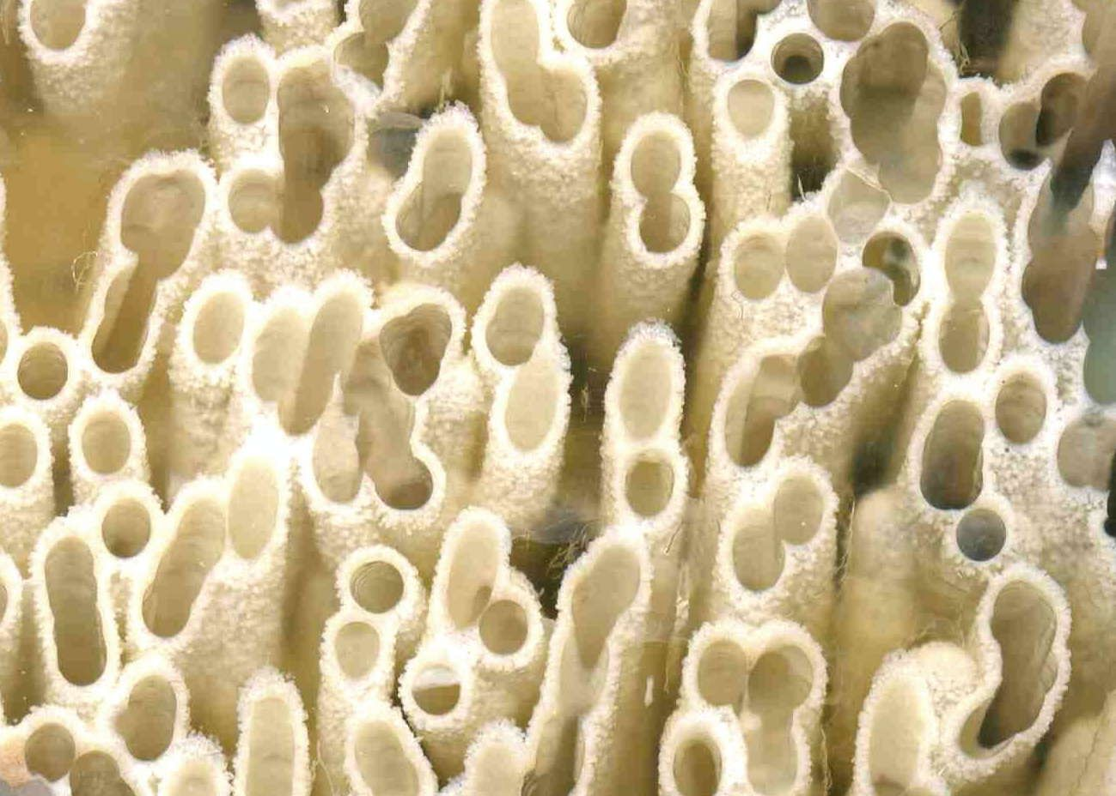
Tube
-More like a stalactite or stalagmite in a cave
-can be coated by several layers of subsequent banding to form eyes when cross cut.
Fairburns Agate
From the Marco Campos-Venuti collection

Slide 13
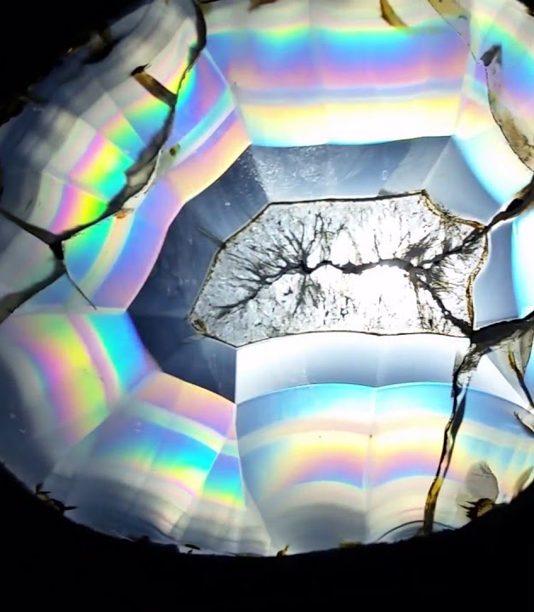
Iris
-Can Happen in any clear, banded agate.
-Light refracts the rainbow.
-Most notable in Montana Moss agates thinly sliced
Fairburns Agate

Slide 14
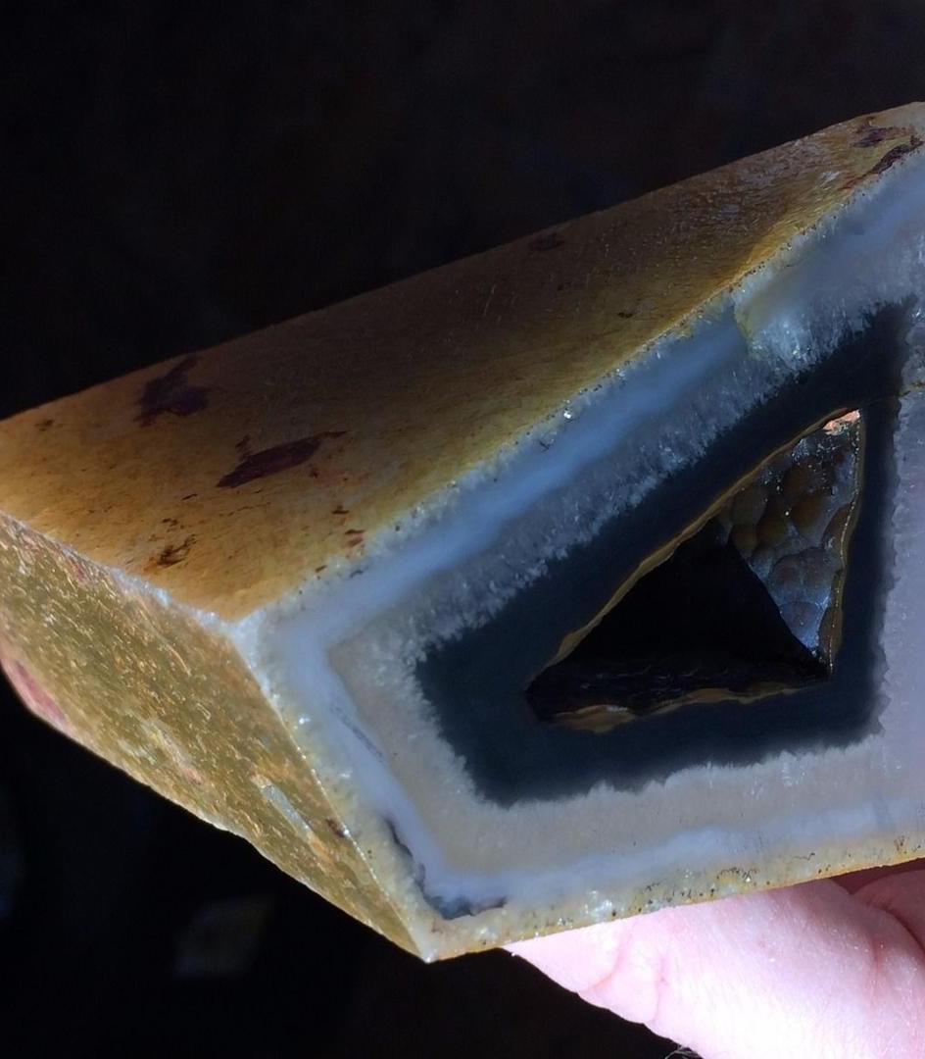
Polyhedroid
-Can combine other traits/types
-Very Rare
-Formed between huge crystals of other minerals that disolved
Fairburns Agate

Slide 15
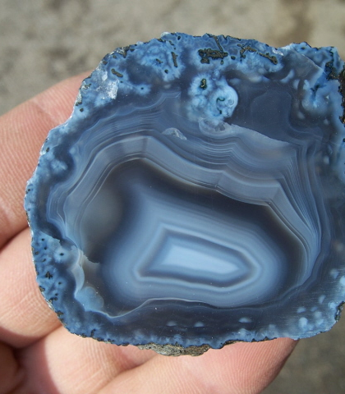
Shadow
-Light bounces between banding lines and returns slightly delayed.
-Creates a shadow line that travels around bands as rock is moved
-Found in Botswanna agates and Mexican Coconuts
Fairburns Agate

Slide 16
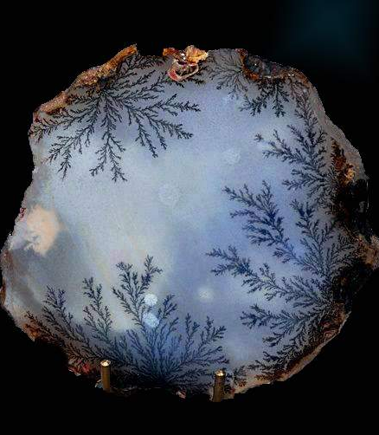
Dendritic
-Often manganese inclusions that travels along banded layer separation.
-Separation heals trapping dendrites
-Small thin tree like inclusions rarely any color other than black
Fairburns Agate

Slide 17
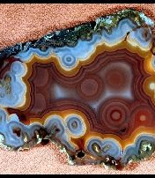
Eye
-Banding forms around tubes or other inclusions
Fairburns Agate

Slide 18
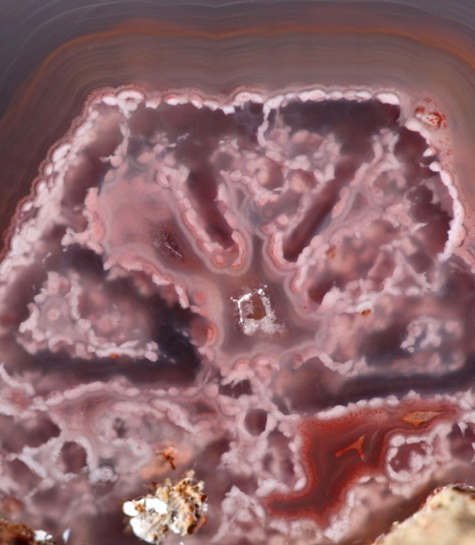
Pseudomorph
-Moss, banding or plumes form around a previous mineral impurity.
-Original impurity is indistinguishable or completely replaced
Fairburns Agate

Slide 19
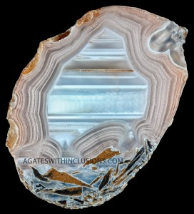
Water Level
-Seen in many Brazilian Agates and thundereggs
Fairburns Agate

Slide 20
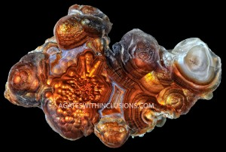
Fire
-Iron Oxide showing iridescence between layers of banding
Slaughter Mountain and Deer Creek produced some of the finest.
Fire Agate

Slide 21
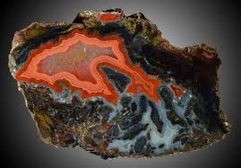
Combinations
-Name the same by the most striking or predominate characteristic.
-The combinations are endless.
-Unusual combinations command high prices with collectors.
Fairburns Agate
Bouhamza Black

Slide 22
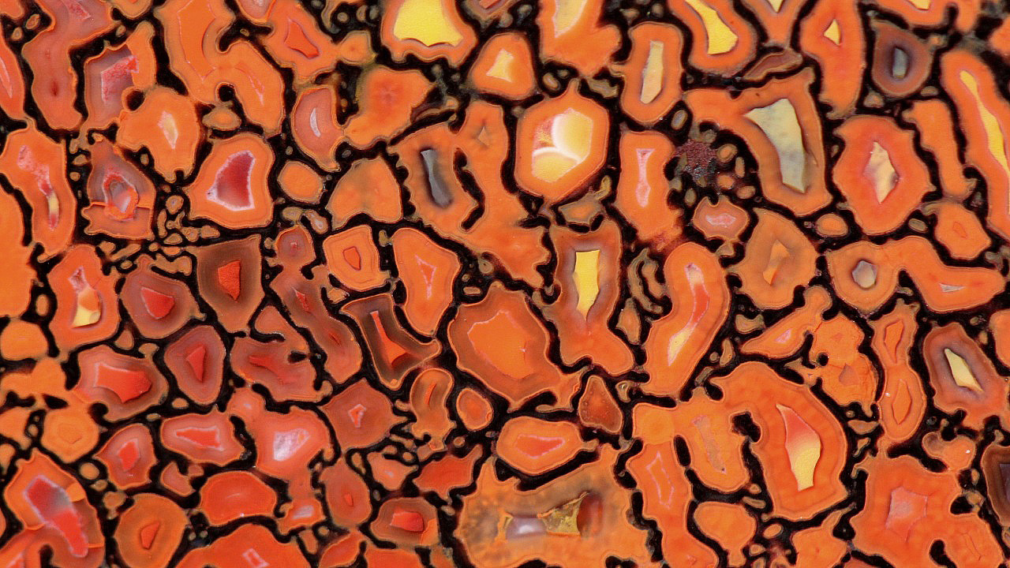
Just Pictures
Dino Bone cells

Slide 23
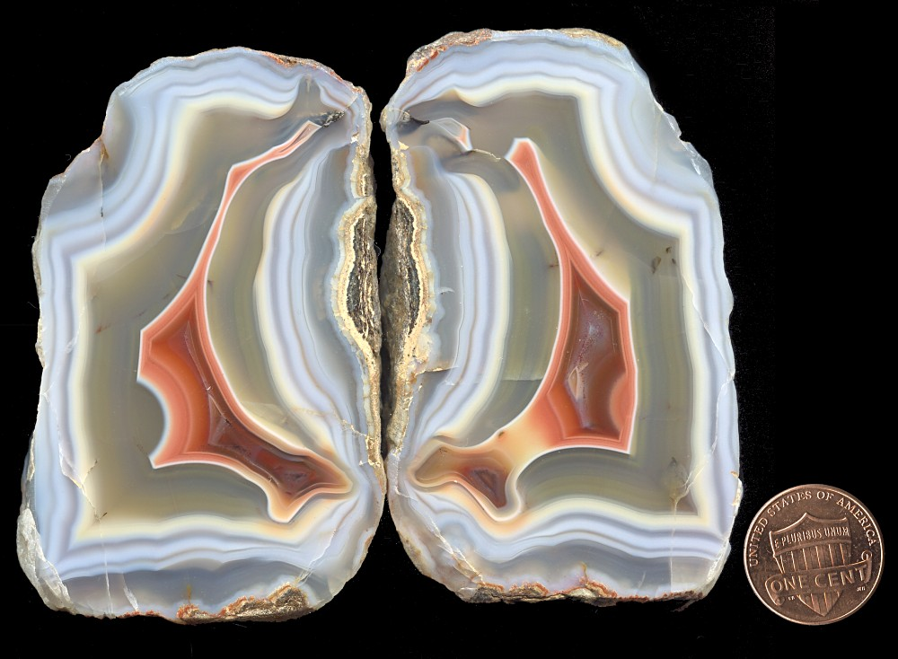
Malawi Agate
Africa

Slide 24
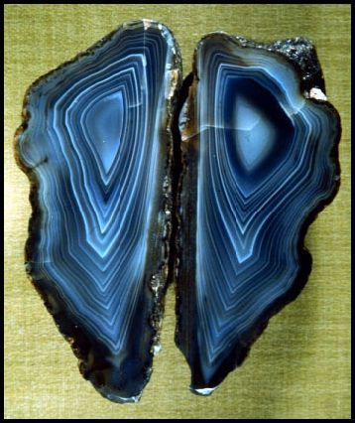
Indian Black Skin Agate
India

Slide 25
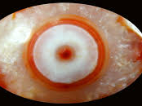
Lake Superior Agate
Michigan

Slide 26
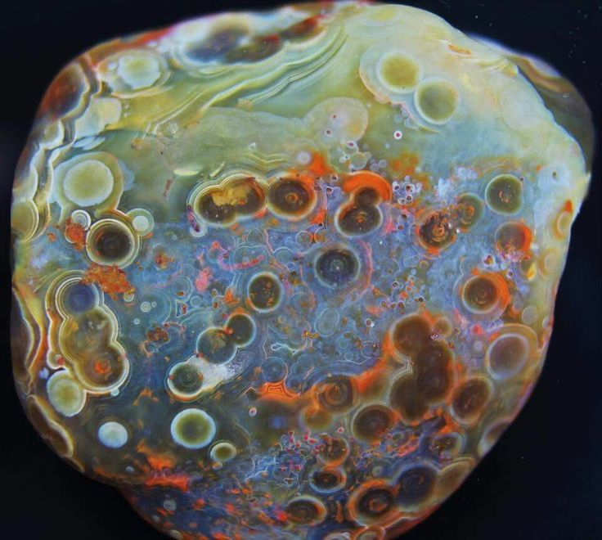
Lake Superior Agate
Michigan

Slide 27
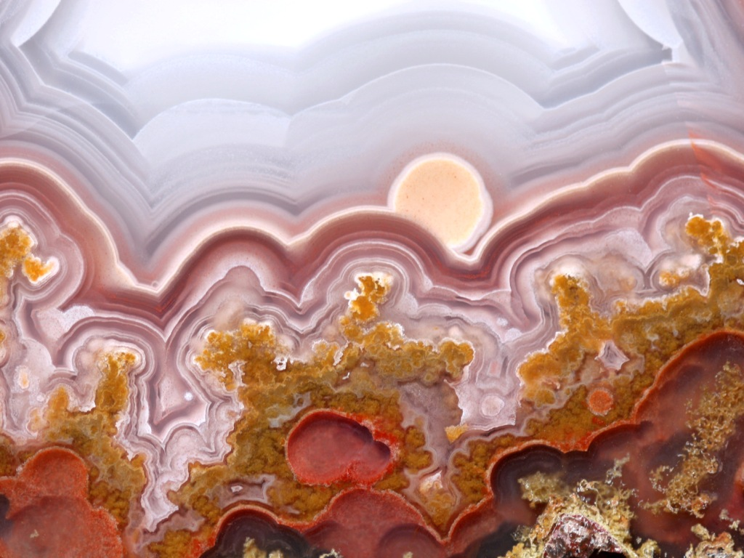
Agua Nueva Agate
Mexico

Slide 28
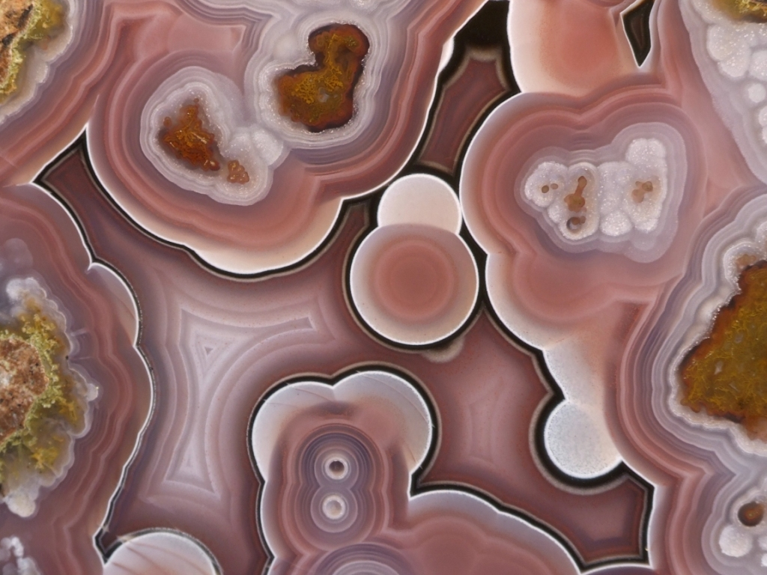
Agua Nueva Agate
Mexico

Slide 29
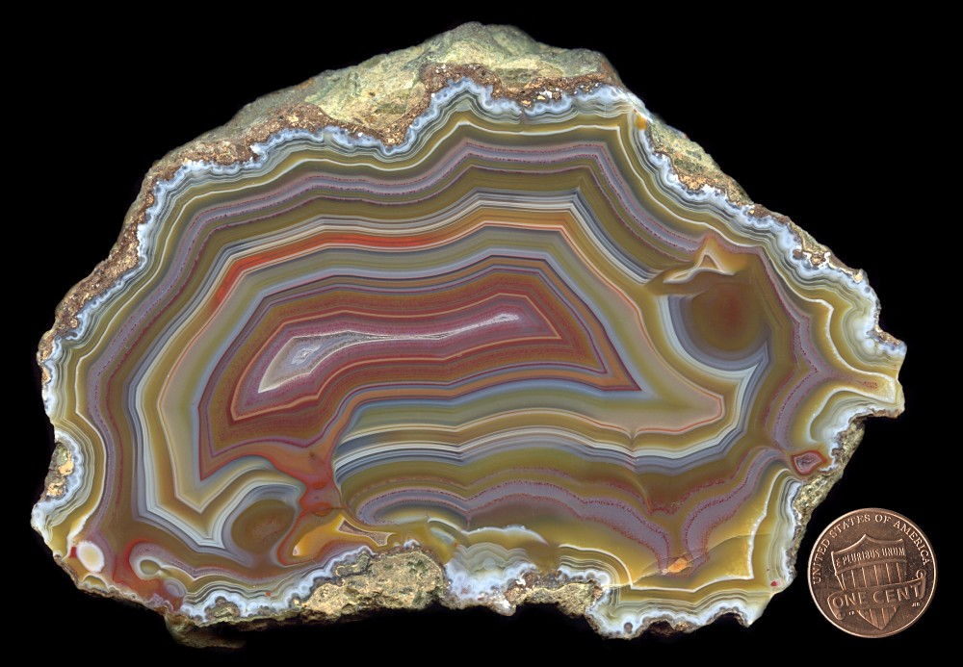
Condor Agate
Patagonia

Slide 30
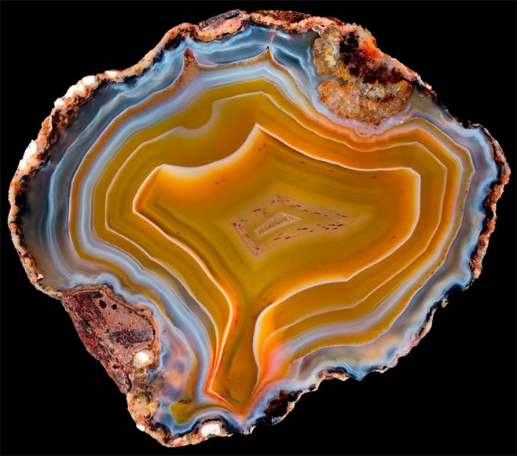
Condor Agate note the valve
Patagonia

Slide 31
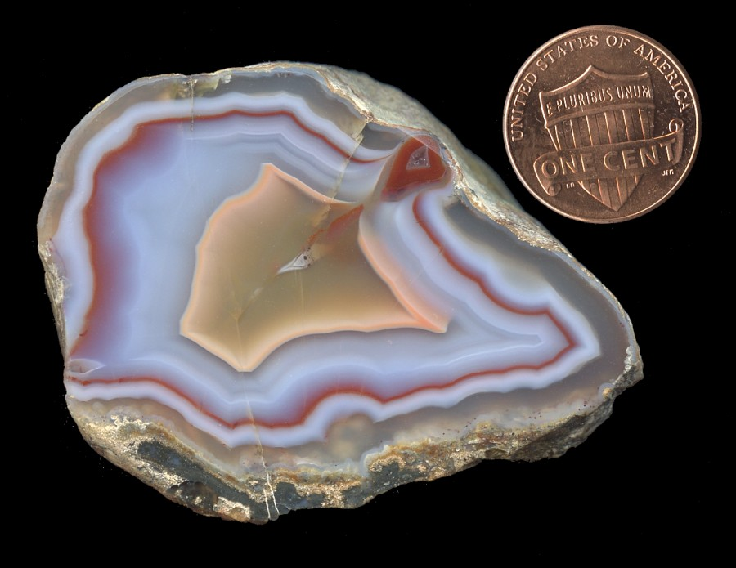
Malawi Agate note the valve
Africa

Slide 32
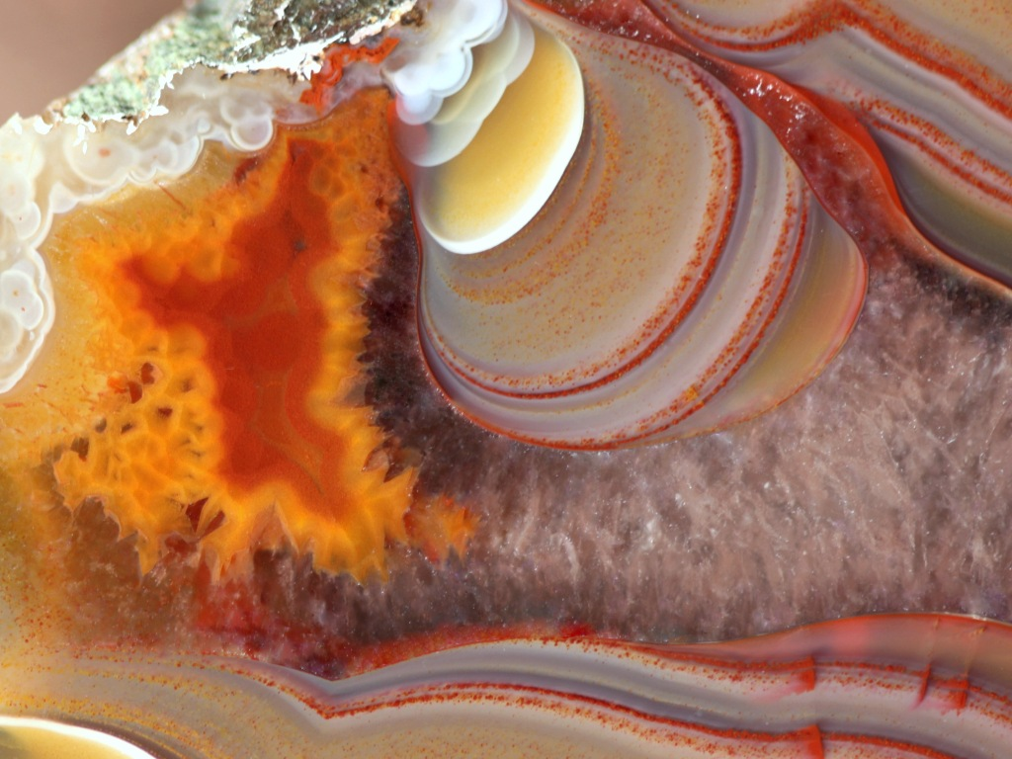
Condor Agate
Patagonia

Slide 33
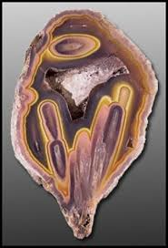
Coyamito Agate Pseudomorph
Mexico

Slide 34
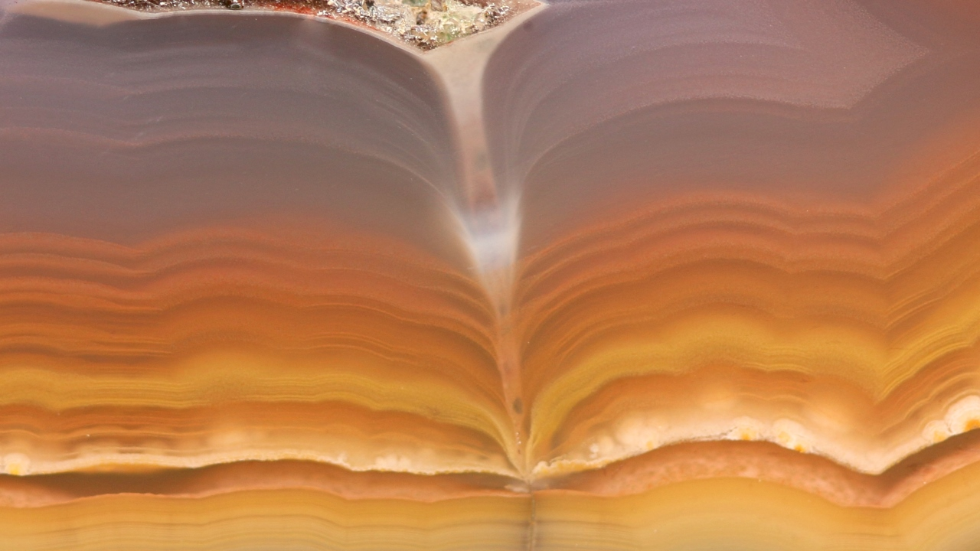
Coyamito Agate note the valve
Patagonia

Slide 35
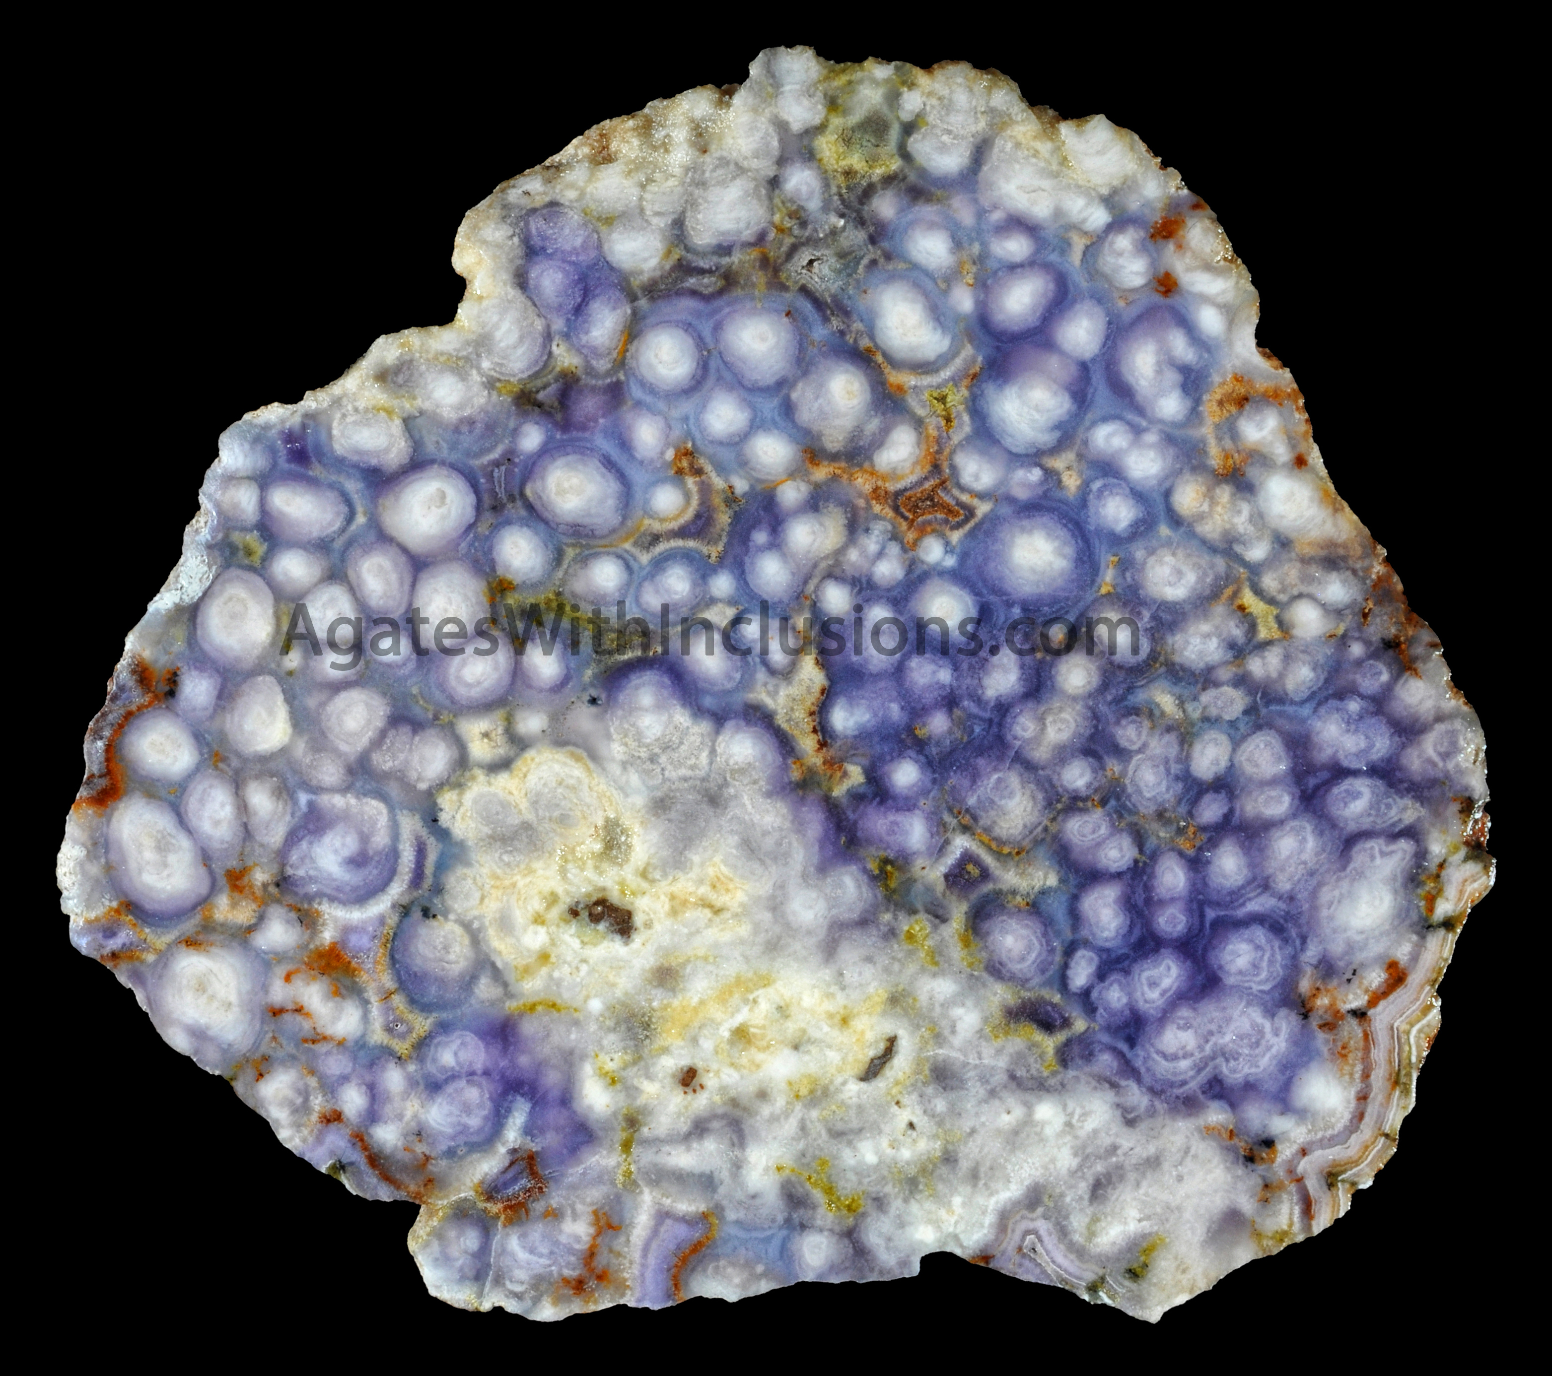
Geyser pipe Agate
Burro Creek Arizona

Slide 36
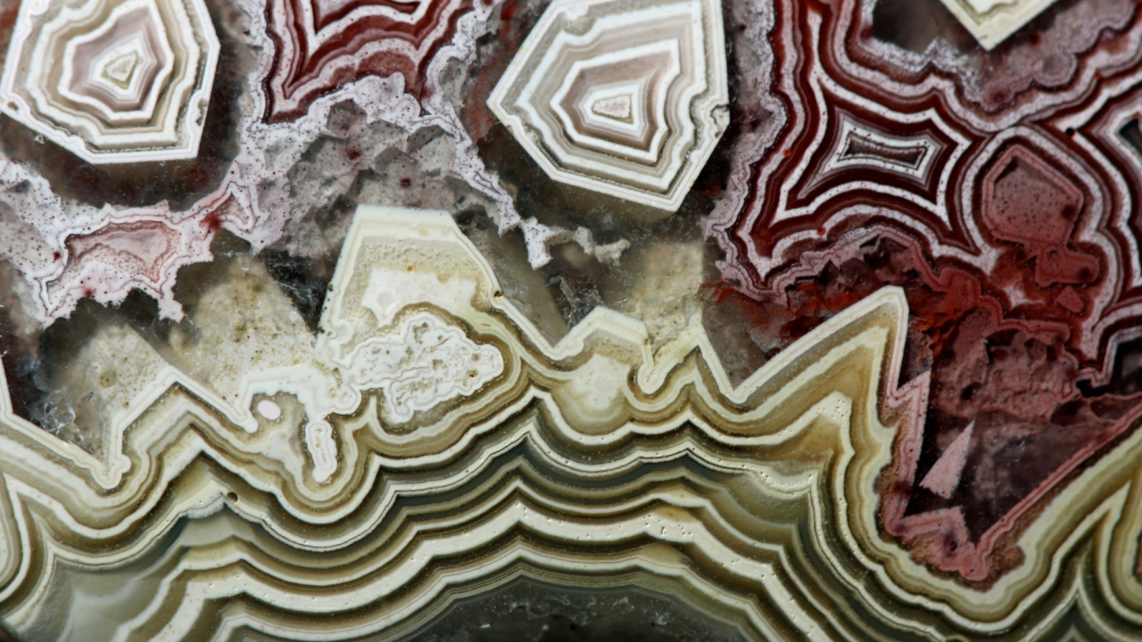
Laguna Lace Agate
Mexico

Slide 37
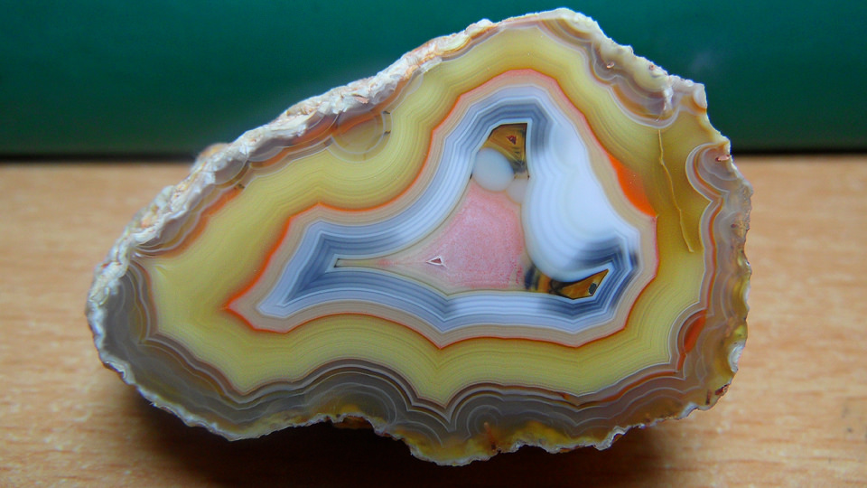
Moctezuma Agate
Mexico

Slide 38
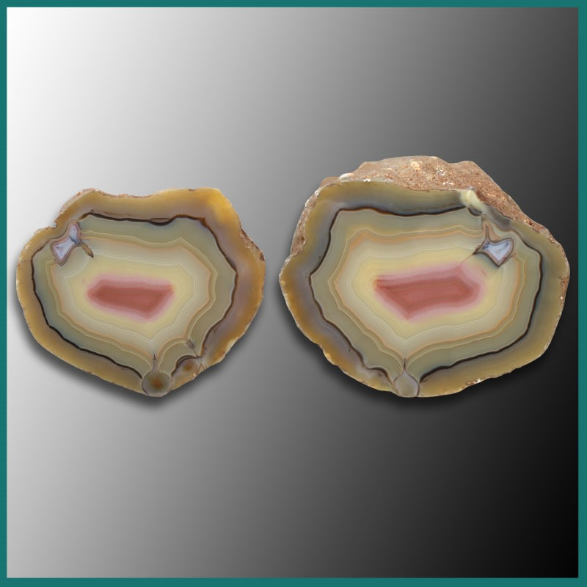
Moctezuma Agate
Mexico

Slide 39
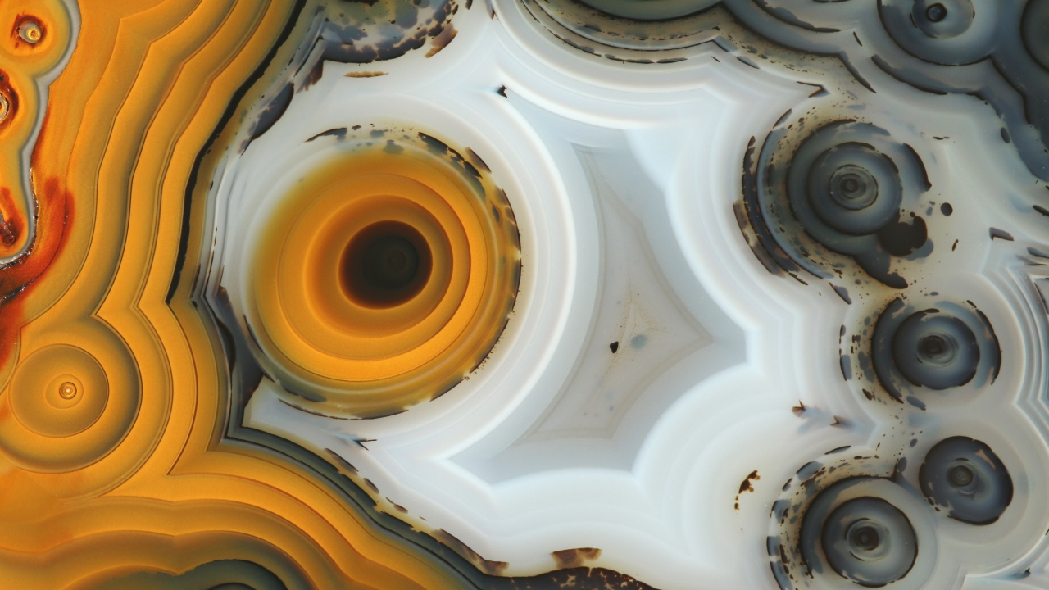
Moroccan Agate
Morocco

Slide 40
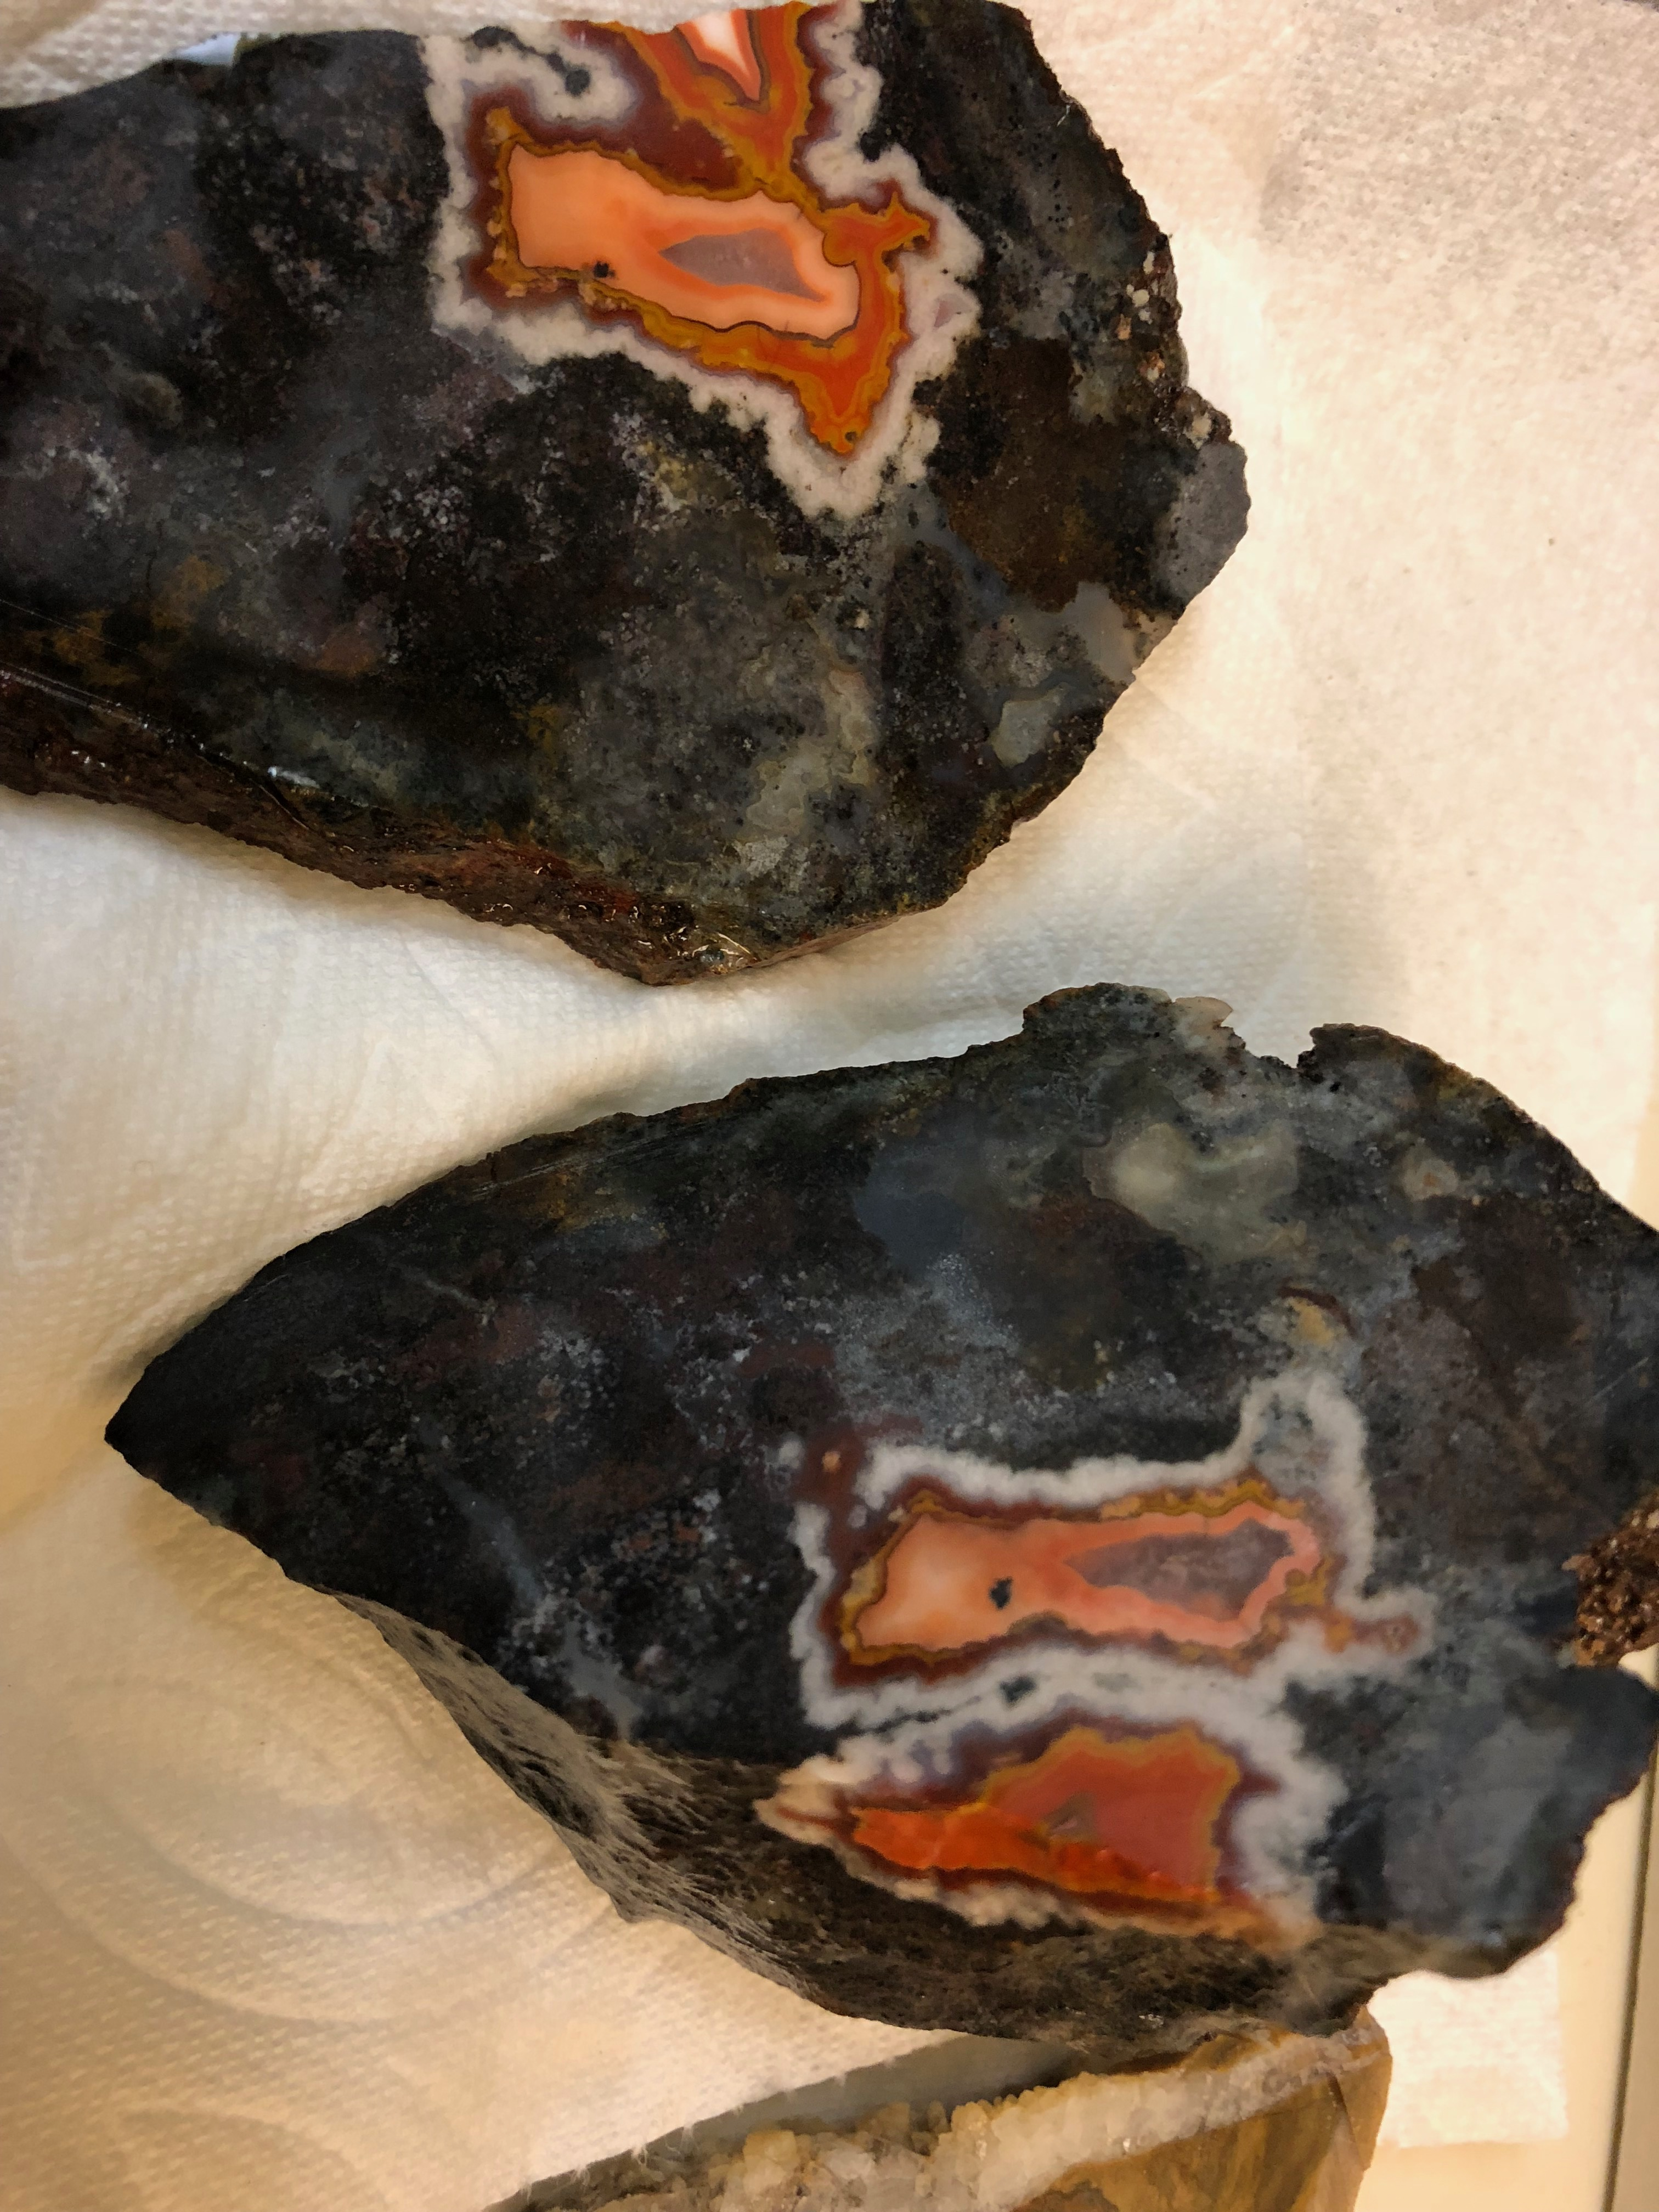
Bouhamza Black Agate
Morocco

Slide 41
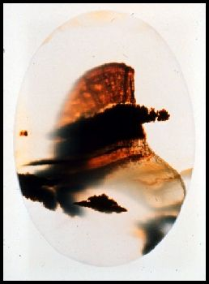
Montana Moss Agate
Yellow Stone River Montana

Slide 42
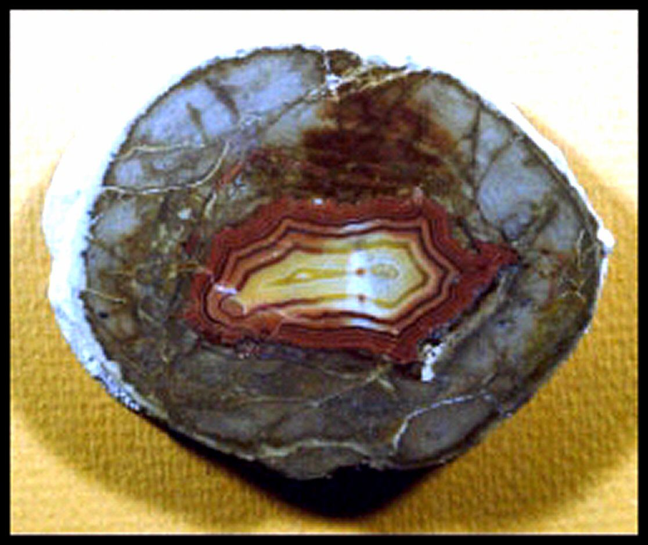
Teepee Agate
Teepee Canyon South Dakota, Limestone agate

Slide 43
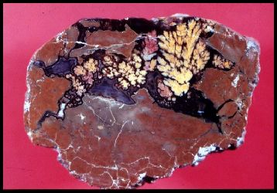
Priday Plume Agate
Richardson Ranch Oregon

Slide 44
Bibliography
Pat McMahan website Agateswithinclusions.com (has the best table side book for sale on Amazon)
Unknown Internet Pictures
Personal collection

